Slide 1
From global to local: learning from TESS-India’s approach to OER localisation across multiple Indian states
Presented by
Leigh-Anne Perryman, OER Research Hub Fellow
Tim Seal, TESS-India Technical Director
Additional author
Alison Hemmings-Buckler
OER14
Notes:
Total - 18:30

Slide 2
The power of OER and the removal
of ‘unfreedoms’
‘Unfreedoms’: e.g. poverty, limited economic opportunity, inadequate education and access to knowledge, deficient health care, and oppression
‘Increasing the freedoms that men and women enjoy is a definition of development, and greater freedom empowers people to be more effective agents of development.’ (CoL 3 yr Plan)
OER: more teachers; better teachers; more engaged learners; improved learner retention; better access to knowledge.
Photo: Leigh-Anne Perryman CC-BY
Notes:
Leigh-Anne [2 mins]
I’m Leigh-Anne Perryman, and I’m an OER Research Hub Fellow. I’ve spent the last year conducting collaborative research with Tim Seal and Alison Buckler from the UK Open University OER in teacher education project TESS-India. The latest phase of this research concerns OER localisation, which is our focus today.
First, I’d like to set the scene a little by referring the Nobel Laureate Amartya Sen, who has great relevance for our research, which operates in the context of international development.
Sen states that a key aim for international development is the removal of unfreedoms which limit human beings’ potential to fully participate in society. LIST….
The Commonwealth of Learning’s 3 Year plan makes an explicit reference to Sen’s ideas when explaining that: QUOTE
The project we’re discussing today - TESS-India - operates on an underlying belief that OER can help remove unfreedoms in a development context by providing better teachers, more engaged learners, improved learners retention and, consequently, better access to knowledge.

Slide 3
The need for OER localisation
“What is the future of open education? Where is it going? I think there is only one answer: localisation” (David Wiley)
“Localization must involve locals; ...effective localization is directly proportional to understanding local contexts.” (Tiffany Ivins)
“Localization
unlocks the
power of OER.”
(Tiffany Ivins)
Photos: Leigh-Anne Perryman CC-BY
Notes:
Leigh-Anne: [1 min]
Localisation – adaptation of resources to meet the particular needs of end-users, especially those in the developing world – is one of the OER movement’s biggest challenges, but also one that is under-explored and under-critiqued.
Way back in 2005, OER localisation was identified by David Wiley as crucial to achieving the aims of the open education movement: QUOTE
What is the future of open education? Where is it going? I think there is only one answer: localisation.
OER localisation can include changing the language, pedagogical approach, content, style, imagery, and the religious, cultural and geographical references featured in resources.
Without localisation, resources produced outside the country in which they are to be delivered can appear irrelevant and inaccessible to end-users. Tiffany Ivins (2012, p. 219) confirms that ‘localization unlocks the power of OER’.
With a few exceptions, in the 9 years since David Wiley’s statement above little work has been done investigating how best to localise OER.

Slide 4
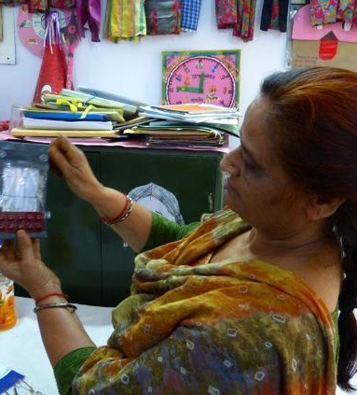
Our research focus
The challenges to localising OER for use in development education
The impact of context and localiser perceptions
How best to support OER localisers
The relationship between institutional quality control, localiser freedom, and the spirit of open.
Photo: Leigh-Anne Perryman CC-BY
Notes:
Leigh-Anne: (20secs)
We cover four main areas in the research presented today:
The challenges to localising OER for use in development education
The impact of context and localiser perceptions
How best to support OER localisers
The relationship between institutional quality control, localiser freedom, and the spirit of open.

Slide 5
Quantity and quality
India: needs 1.33 million teachers
Bihar: 75% of teacher ed. colleges did no training between 2007-2010
India - Bihar: 45% of teachers don’t have minimum qualification.
India: some states, only 1% pass Teacher Eligibility Test
India – ASER: “A ritual exercise bringing the same disturbing but worsening news” (Deccan Herald, 2013)
Photo: Eric Parker CC-BY-NC
Notes:
LEIGH-ANNE [1min 20sec]
To provide a bit of context about India’s education system, I’m going to share a few figures with you related to three problems that are addressed by TESS-India: a lack of teachers, poor quality of teaching and, consequently, low standards of learning amongst India’s children.
India‘s education system features an enormous number of unqualified teachers and insufficient capacity to train new and existing teachers.
For example, India currently needs 1.33 million teachers, yet in the state of Bihar, 75 per cent of teacher education institutions did not conduct any training between 2007-2010 (UNICEF, 2010).
Moving from quantity to quality, in Bihar state 45 % of school teachers don’t have the minimum qualification for teaching (MHRD, 2013).
Ranging more widely it’s also a great concern that in some Indian states only 1% of teachers pass the Teacher Eligibility Test – passing which is mandatory to teach in government schools.
Finally, since 2005 the NGO Pratham has been conducting the Annual Status of Education Report which year on year has revealed ever-falling standards of learning, resulting in the Deccan Herald deeming the 2013 report ‘a ritual exercise bringing the same disturbing but worsening news’
There’s a clear need for work to improve the quality of both teachers, and teaching in these two contexts. I’ll now hand over to Tim who will tell you more about TESS-India.

Slide 6
TESS-India - Teacher Education through School based Support in India
Focus States:
Assam, Bihar, Karnataka, Madhya Pradesh, Odisha, Uttar Pradesh, West Bengal
Subject areas:
English, Math Science, Leadership, Language & Literacy
Content:
125 Pan Indian study units
Collaborative development
Stand alone, self directed
Supporting teachers in changing their practice
Suggests and inspires rather than being prescriptive and exhaustive
Promotes reflection
Photo: TESS-India CC-BY-SA
Notes:
Tim: [1:09]
TESS-India is an OER based International development project at the Open University (UK)
DfID funding received in November 2012 and current phase ends May 2015
The project works in 7 states in India outlined here
Focussing on the subjects at both primary and secondary level.
125 Pan-Indian teacher development OER study units are being created in
Materials were developed collaboratively between OU and Indian academics
Teacher development units are stand alone and are self directed in the nature of study - again they look at supporting teachers in making changes in their practice.

Slide 7
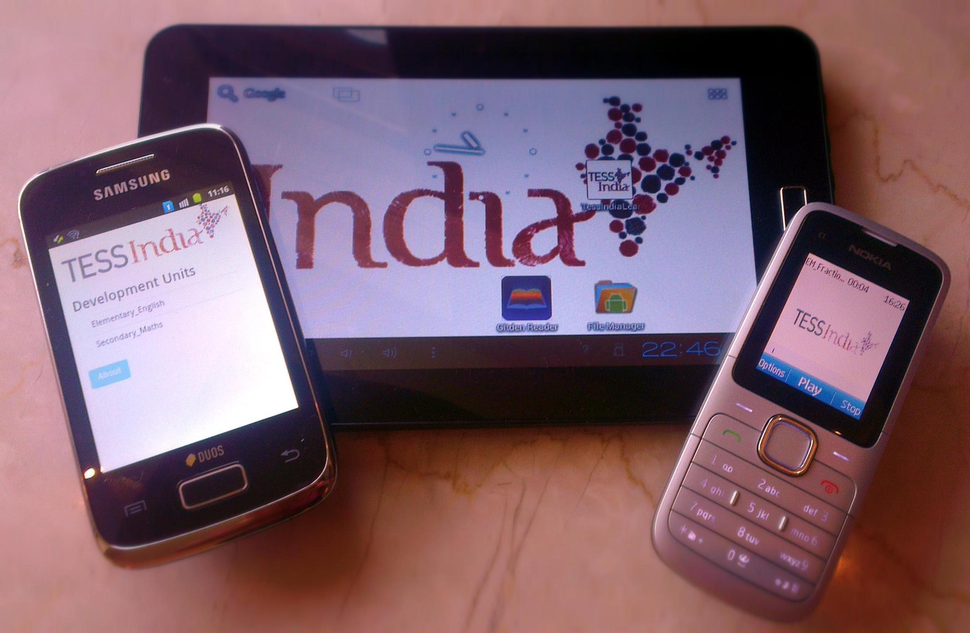
Production
Photos: TESS-India CC-BY-SA
Notes:
Tim: [0:55]
Use of mixed media including text, images and video
Contain multiple activities
Developed using a structured content system to enable flexibility
Materials available in multiple formats

Slide 8
Localisation process
State based orientation workshops.
Content Translation
Third party NGO
State Localisation Managers
Subject Localisation Experts
2 State based Localisation workshops (1 combined)
No direct control of adaptation
Photo: TESS-India CC-BY-SA
Notes:
Tim [3:29]
First thing to note is that only worked on Hindi based materials in three Hindi speaking states and on three subsets of the TDUs: elementary English, elementary science and secondary maths
Materials review / orientation workshops (State level) with organisations like SCERT State Council for Education Research and Training
Worked with a third party NGO to take responsibility for the localisation with support from TESS-India team
They employed localisers at 2 levels
SLMs responsible for QA of all subject based units
SLEs responsible for localising units 2 SLEs per subject strand
Materials were translated into Hindi so localising was completed in local language
State Localisation workshops with SLEs and SLMs localisation workshops have been held, one in Madhya Pradesh and a combined workshop for Uttar Pradesh and Bihar held in Lucknow
Allowed adaptation of all content but guided them through the workshops and handbook to keep the pedagogic approach the same
Versioning was done in local language, so materials were translated before the workshops
There was a technology barrier which was universal in terms of localisers being able type in Hindi

Slide 9
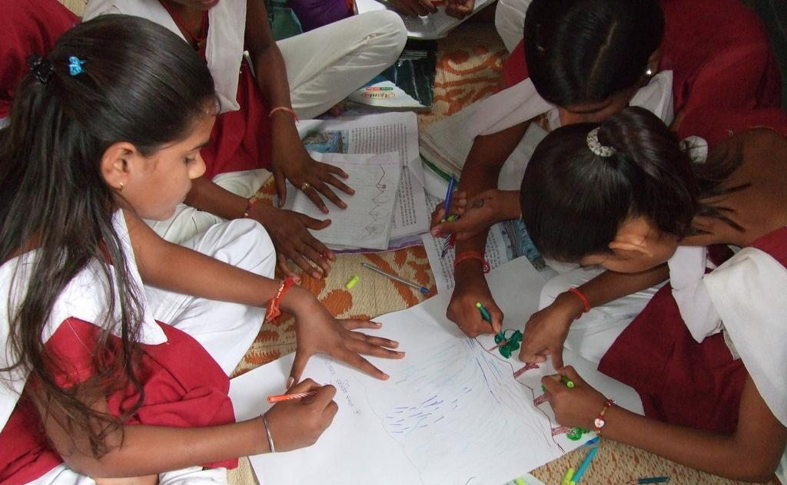
The challenges of localising OER
Managing translation
Use of Hindi keyboard
Navigating localiser perceptions & experience as educators in India
Navigating localiser unfamiliarity with OER, openness & online learning
The relationship between institutional control, quality, localiser freedom and openness
Photos: TESS-India CC-BY-SA
Notes:
Leigh-Anne [30 sec]
Here’s a summary of our findings regading the challenges of localising OER. They’ll each be discussed in more detail later.
Managing translation
Use of Hindi keyboard
Navigating localiser perceptions & experience as educators in India
Navigating localiser unfamiliarity with OER, openness & online learning
The relationship between institutional control, quality, localiser freedom and openness

Slide 10
The challenges of translation
Localisers don’t have translation skills + translation agency doesn’t have context/educational knowledge;
= Distortion of meaning.
Localisers have to correct this, but have to look at English version to do so.
Little use of Hindi keyboard so annotated hard copies used - time consuming.
Photo: Leigh-Anne Perryman CC-BY-SA
Notes:
Leigh-Anne [1 min]
The TESS-India resources were written in English but needed to be translated into Hindi before they could be localised.
Localisers don’t have translation skills + translation agency doesn’t have context/educational knowledge;
= Distortion of meaning.
Localisers have to correct this, but have to look at English version to do so.
A related issue was that there was little use of Hindi keyboard amongst localisers so they annotated hard copies - time consuming. Managing this adds another level of quality assurance to the process.

Slide 11
Navigating perceptions and experience
SLEs’ background as textbook writers
Focus on subject over method
Preference for formal, rather than conversational writing style
Unfamiliarity with activity-based pedagogy
Photo: Leigh-Anne Perryman CC-BY
“Many of the localisers had PhDs and really wanted to engage more with the topic than the technique… they thought that the teacher should have all subject knowledge in one place.”
Notes:
Leigh-Anne [1min 30 sec]
Many of the TESS-India localisers were subject experts who’d written textbooks for Indian education system. This raised a number of challenges.
Some were so senior they were out of touch with on the ground experiences of teachers in their state. Some also had a deeply negative perception of teachers and questioned the value of OER.
One big challenge was navigating the ex-textbook writers’ emphasis on subject over pedagogy (the TESS-India resources emphasise pedagogy over subject); QUOTE
Another challenge was that the ex-textbook writers’ preferred and were used to a formal writing style (which contrasted with the more informal writing style of the TESS-India materials)..
There was also a need to provide training in active learning techniques during the workshops, as these techniques featured heavily in the TESS-India resources but were not commonly understood by the localisers..

Slide 12
Development & OER
Neo-Colonialism
Knowledge partnership
The OER Engagement Ladder © 2012 Joanna Wild, CC-BY
Notes:
Tim [2:05]
Talk through the slide - as in where our localisers are.
So what we have done is look at Joanna Wild’s OER engagement ladder and applied an approach to development over this.
If we look at those localisers or users of the content as being at the bottom of the ladder with no understanding of OER importing education into a country can be seen in the extreme as a neo-colonial approach to development and teacher education although we clearly did not start from this perspective from our collaborative approach to development and the fact that the content is OER but one might see how this could perceived for those at the bottom of the ladder of engagement. And we did have comments at the beginning of the workshops such as it being very English centric.
What we are suggesting is that as those involved in adaptation of OER become more aware and move up the ladder of engagement so they view of development changes from neo-colonialism to one of a knowledge partnership.
Increased OER engagement of content developers and a supported approach to adaptation naturally moves one from a neo-colonial approach to development to a more knowledge partnership based approach.
Increasing OER engagement implicitly supports more appropriate, valuable and collaborative approaches to development.

Slide 13
Context
Hierarchical view of knowledge ownership
No understanding of OER
“We need to allow time for reflection and working on the materials.”
“We need to sit as a group again to deliberate on matters of localisation as now our understanding of the matter has increased.”
Photo: TESS-India CC-BY-SA
Notes:
Tim [0:52]
In order for this to be successful the process by which localisation occurs and therefore engagement increases needs to contextualised within itsself for example within the TESS India context the Hierarchal view of knowledge ownership may make it harder to move those contexts onto the first rung of the ladder if you like.
with ladder?

Slide 14
Conclusion: Creating a knowledge partnership
Institutional (quality) control & guidance
Respect for individual perceptions & experience
Sensitivity to context (e.g. status of knowledge ownership)
Knowledge partnership
Openness & ‘embedded’ engagement with OER
Notes:
Tim [0:30]
So at the knowledge partnership end of the development spectrum we can see how some of the factors that make up the knowledge partnership approach map onto the higher level characteristics of the OER engagement ladder. Embedded, strategic and reflective.

Slide 15
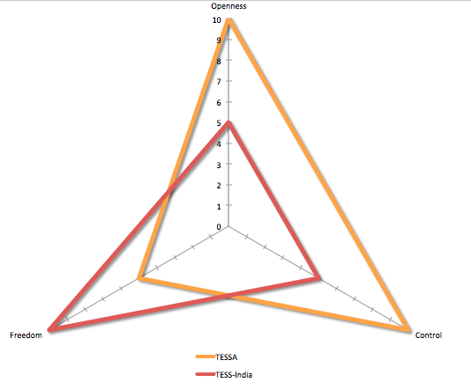
Conclusion: Quality, control, freedom and openness
“I would like to see more from the State people… like if they want to see more assessment done in the classroom or if they want more attention paid to low achievers that sort of thing… Really, I’d like more radical localisation rather than safe localisation but there’s a reluctance, a deference that gets in the way.”
(TESS-India Academic Manager, 2014)
Notes:
Leigh-Anne [1min 45sec]
To conclude, I’d like to share an emergent model for concepetualising the relationship between institutional control of the localisation process in the interests of quality, localisers’ subsequent freedom, and the level of openness in the localisation process.
The two-tier TESS-India localisation process features a quite directive initial phase of resource adaptation, intend to offer a way of ensuring that the changes that are needed to meet local needs actually do take place during the production process, while also allowing for further localisation by teachers and teacher-educators once they have bought in to the resources’ use within their own practice.
Here, we’ve represented an apparent dynamic between institutional control, localiser freedom and the level of openness involved in the localisation progress diagrammatically. Note that this is not a quantitative representation and the numbers are just a rough guide showing direction for each element of the diagram.
A comparison with the TESSA OER project, operating in sub-Saharan Africa, suggests that openness may be positively connected with the degree of initial control over the localisation process.
While in both projects versioning was intended from the start, TESSA managed this process more tightly by determining sections of the materials that could be versioned, and sections that couldn’t.
Versioners were free to adapt to their own contexts within this framework.
Might be anticipated that the controlled nature of the process in TESSA prevented some versioners from fully engaging with the concept of being a ‘partner’ in the process. However, it actually led to more changes than with TESS-India where localisers were reluctant to change the work of other academics.

Slide 16
www.TESS-India.edu.in
www.oerresearchhub.org
@TESSIndia @oer_hub @laperryman
@tim10101 @goldensyrupgirl
All images CC-BY-SA TESS-India and CC-BY-SA Leigh-Anne Perryman (as stated on slide)
Notes:
I hope that our presentation has raised some issues regarding OER localisation in all contexts, not only in international development. We’d be happy to answer any questions.

